Slide 1

Module 3. Scoring & Assessing Concept Maps
Notes:
https://sites.google.com/dforxconsulting.com/emcmaptoolkit/module-3-scoring/scoringtool

Slide 2
Depending on your goals, cmaps can be scored in a variety of ways.
Qualitative
Quantitative
Holistic
Counting Components
Categorical
Proposition Rating
Rubric
Similarity/Match
Coding Concepts
[8]
Notes:
2:25
We usually incorporate both methods when evaluating concept maps because we learn different things from each and it’s also valuable for our scholarship.
After we test one of each, we’ll talk about pros and cons

Slide 3
Five types of scoring methods
Scoring Method | Concept Map Scoring Metrics
Traditional | Knowledge Breadth | Knowledge Depth | Knowledge Connectedness
Categorical | Category Analysis | Complexity Analysis
Holistic Rubric | Comprehensiveness | Organization | Correctness
Structural (Holistic) | Pattern/Complexity
Comparison to Master/Reference Map | Comprehensiveness | Connectedness | Similarity
Notes:
We usually incorporate both quantitative and qualitative methods when evaluating concept maps because we learn different things from each and it’s also valuable for our scholarship. Not all scoring approaches work with every assignment type. For example, scoring with the traditional or holistic rubric may not make sense for a “Fill-in-a-map” assignment because you do not expect the structure/complexity of the student maps to vary much. Comparison to a reference map probably makes the most sense for that type of assignment.
After we test one of each, we’ll talk about pros and cons

Slide 4
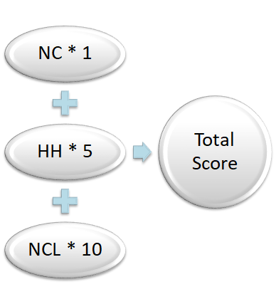
Quantitative Scoring Method: Traditional
Number of concepts (NC) represents knowledge breadth sub-score.
Highest level of hierarchy (HH) represents knowledge depth.
Number of cross-links (NCL) represents knowledge connectedness.
Longest path is alternate for knowledge depth.
[2, 4, 8]
Notes:
Elise

Slide 5
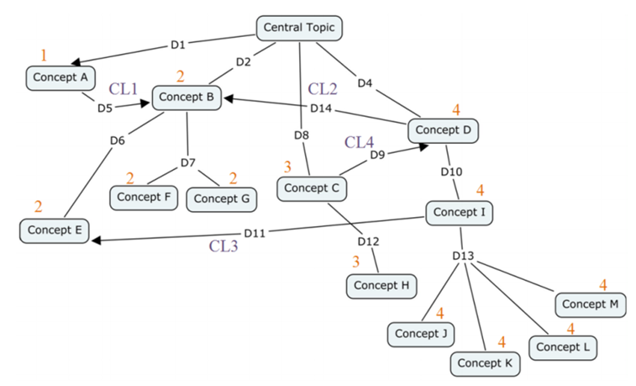
Quantitative Scoring Method: Traditional
NC = 13
NH = 4
HH = 3
NCL = 4
Tot = 68
[4]
Notes:
Practical tip: label your concept map like on this slide; makes scoring much easier; have a different color pen

Slide 6
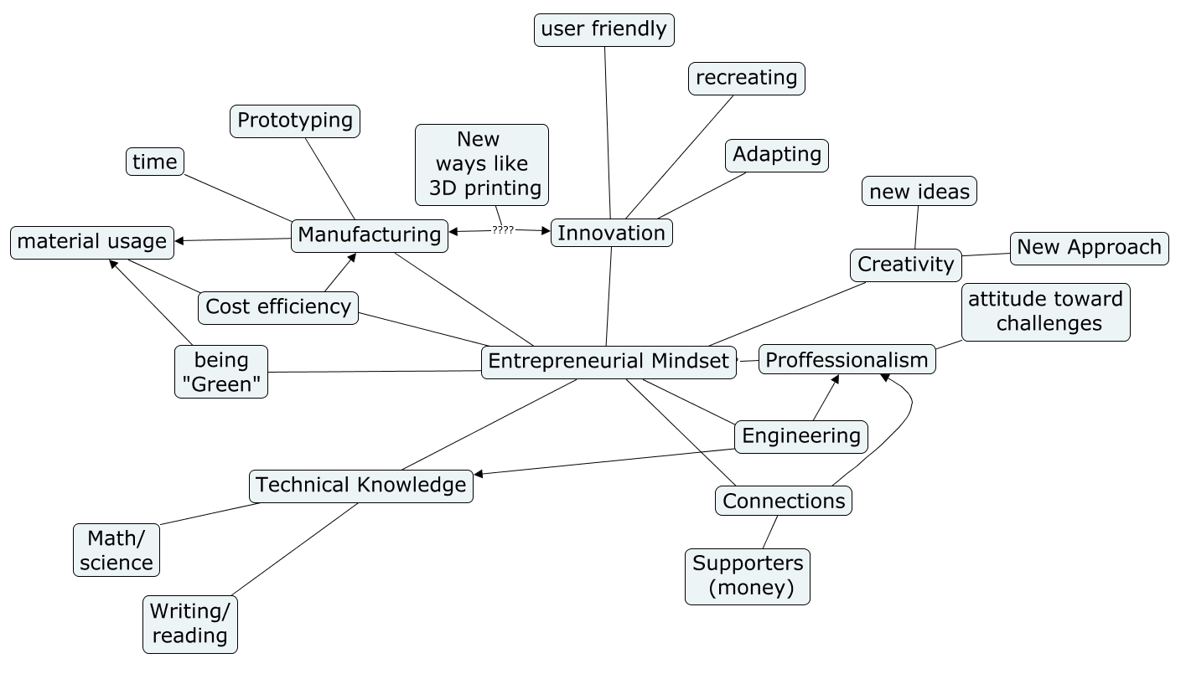
Quantitative Scoring Method: Traditional
NC = 22
HH = 2
NCL = 5
Tot = 82
Notes:
Elise - turn to page 3 in your handout and practice scoring this concept map

Slide 7
Activity: Score the concept map you created in Module 1
Traditional method:
No. Concepts =
Highest Hierarchy =
No. Cross-Links =
Total (weighted) =

Slide 8
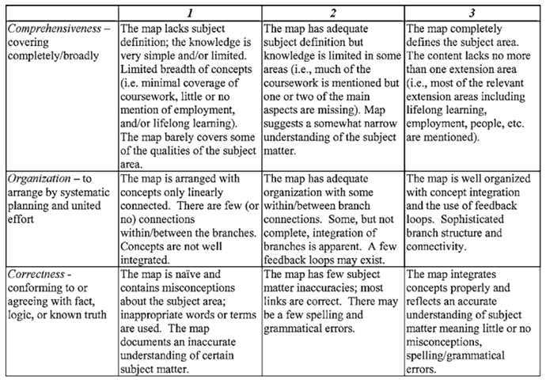
Qualitative Scoring Method: Holistic Rubric
Half points can be added between the anchors for maps that don’t fall clearly into one of the main headings (1-3)
[2]

Slide 9
Holistic Scoring Method: Comprehensiveness
Entrepreneurial mindset assessed based on inclusion of concepts that fall into the following 9 categories:
Innovation/Creativity
Entrepreneurial Affect
Product Development
Money
Customer and/or Stakeholders
Value
Business Skills
Professional Skills
Technical Skills
[7]

Slide 10
Holistic Rubric Method: Comprehensiveness
Maps that contained:
  2 of the 9 categories would score a 1
  3 or 4 of the 9 categories would score a 1.5
  5 or 6 of the 9 categories would score a 2
  7 or 8 of the 9 categories would score a 2.5
  all 9 categories would score a 3
Raters should reference adjacent branches if there was uncertainty about which category the term best fits
[7]

Slide 11
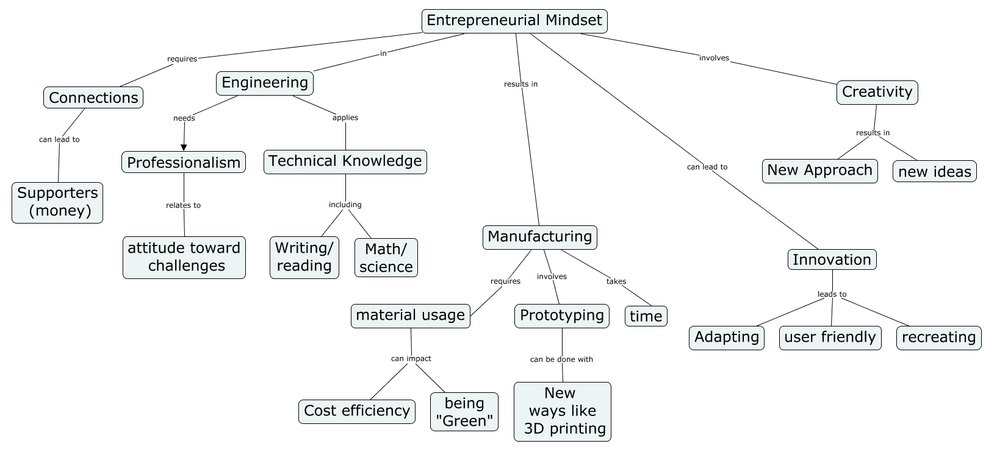
Example: Holistic
Comprehensiveness =
Organization =
Correctness =
Tot =
Notes:
Score the Fill-in-Map example
Turn to page 3 in your handout and practice scoring this concept map - participants practice scoring
Then walk through the solution on the slide

Slide 12
Example: Holistic
This map contains terms from the following categories:
  Innovation/Creativity (i.e. innovation)
  Product Development (i.e. manufacturing, prototype)
  Resources needed (i.e. time)
  Customer and/or Stakeholders (i.e. supporters)
  Business Knowledge and Skills (i.e. cost efficiency)
  Professional Knowledge and Skills (i.e. professionalism)
  Technical Knowledge and Skills (i.e. math/science, writing/reading).
Total categories = 7; Comprehensiveness score = 2.5
Notes:
Take a look again at the cmap on Page 3
Cheryl

Slide 13
Example: Holistic
Comprehensiveness = 2.5
Organization =
Correctness =
Tot =
Notes:
Krista
Score the Fill-in-Map example
Turn to page 3 in your handout and practice scoring this concept map - participants practice scoring
Then walk through the solution on the slide

Slide 14
Holistic Rubric Method: Organization and Correctness
Organization
Determined based on number of branches and feedback loops (connections between branches)
Maps that score a 1 are linear in nature and contain no feedback loops
Maps that score a 3 contain many branches/sub-branches as well as cross-links
Correctness
Determined based on correct application of the term within the map structure
Default score of 3 with ½ point deducted for each error or misconception observed
Notes:
Practical tip: you can calibrate the rubric for your activity or your set of concept maps; important to use the anchors consistently, especially if more than one person is using the activity and scoring the concept maps
For both quant and qual methods, we tend to use training and calibration sessions for multiple scorers
For research, we have more than one person scoring each map and look at interrater reliability
Cheryl

Slide 15
Example: Holistic
Organization = 3
  Map has several branches and sub-branches
  Contains a number of feedback loops between terms
Correctness = 3
  All terms are used appropriately within the map
Notes:
Cheryl

Slide 16
Example: Holistic
Comprehensiveness = 2.5
Organization = 3
Correctness = 3
Tot = 8.5
Notes:
Krista
Score the Fill-in-Map example
Turn to page 3 in your handout and practice scoring this concept map - participants practice scoring
Then walk through the solution on the slide

Slide 17
Activity: Score your concept map
Holistic method:
Comprehensiveness =
Organization =
Correctness =
Total =
Notes:
Try scoring your map!
Cheryl

Slide 18
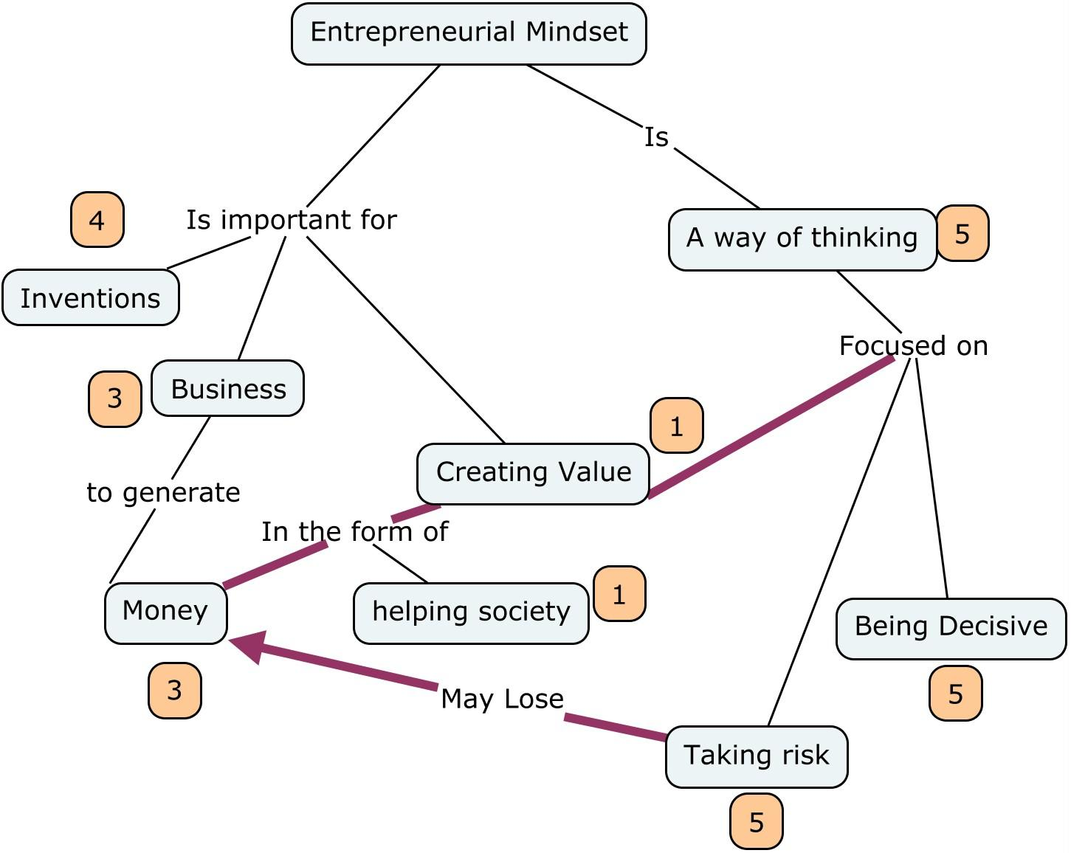
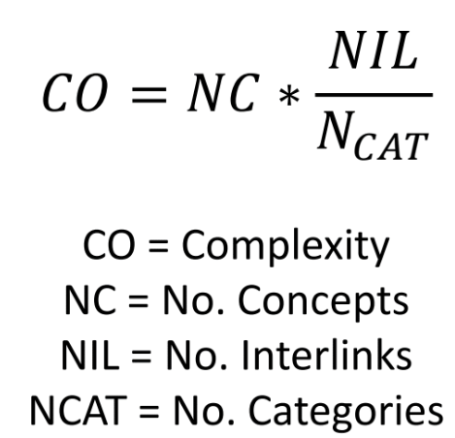
Mixed Method Approach: Categorical Scoring
Step 1: assign each concept to a category.
Value Creation
(Design) Process
Business/
Organization
Innovation/IP
KSAs
Other
Step 2: count “interlinks” between different categories.
Step 3: calculate complexity index.
Notes:
For the categorical, we are demonstrating the 5 main categories in a master map and codebook that our team is developing.

Slide 19
Categorical Scoring Method: Example
NC = 22
NCat =
NIL =
CO =
Notes:
Step 0: count the number of concepts (if not already done with traditional)

Slide 20
Categorical Scoring Method: Example
NC = 22
NCat = 5
NIL =
CO =
2
5
5
5
5
4
4
3
5
5
3
5
4
3
2
3
3
1
2
4
1
4
Notes:
Step 1: Assign each concept to category - each category is used at least once except for “other”

Slide 21
Categorical Scoring Method: Example
NC = 22
NCat = 5
NIL = 6
CO = 26
2
5
5
5
5
4
4
3
5
5
3
5
4
3
2
3
3
1
2
4
1
4
Notes:
Krista
Step 2: Count interlinks

Slide 22
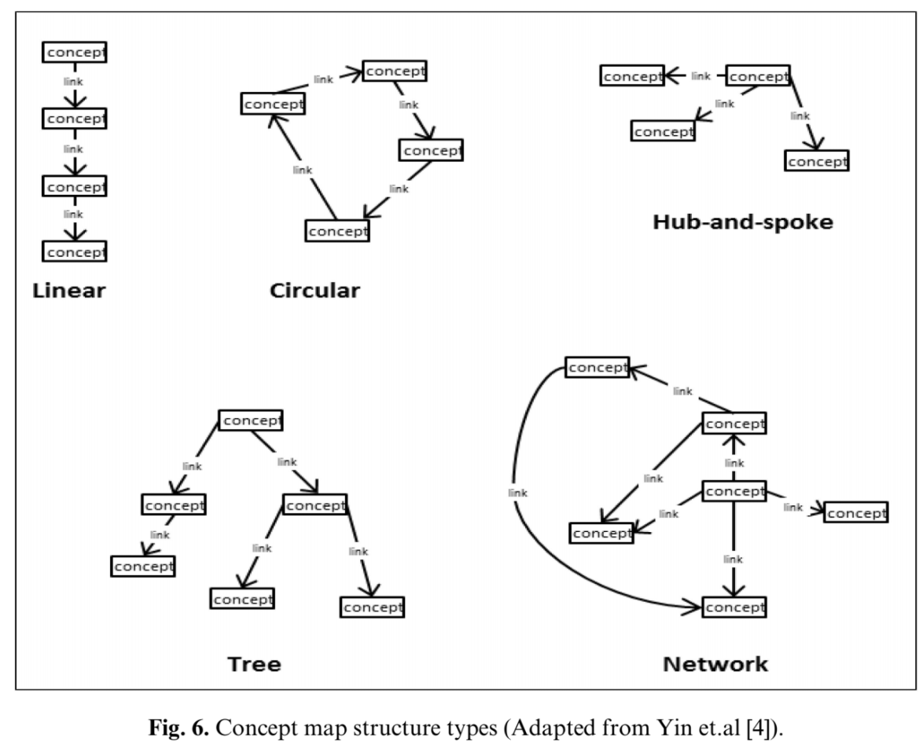
Holistic (Structural) Approach

Slide 23
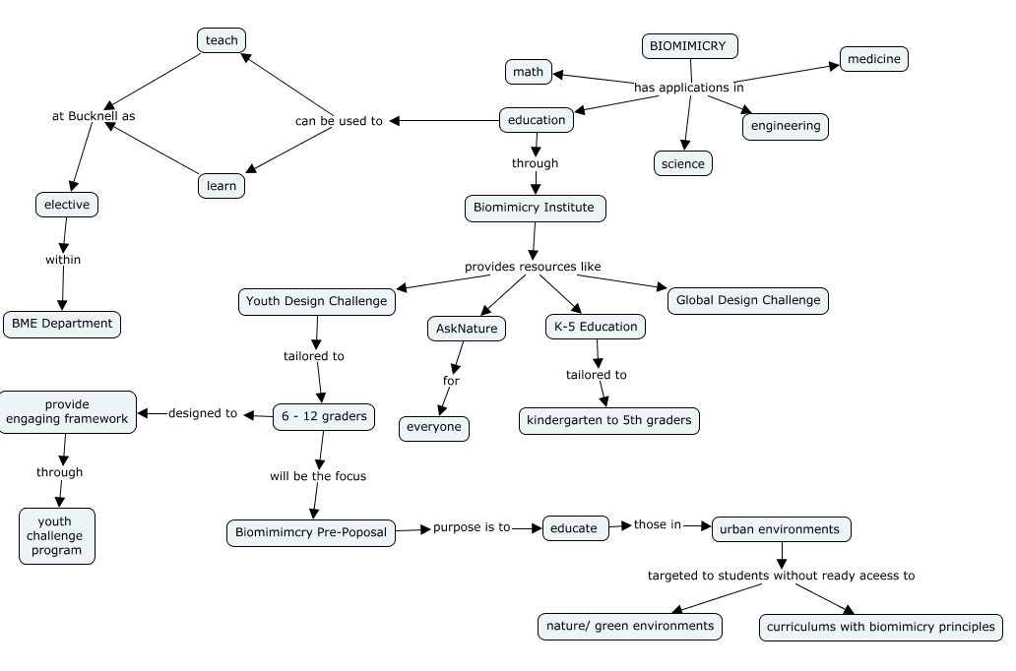
Examples
Classify the dominant structure
Linear
Chain
Hub/spoke
Tree
Network

Slide 24
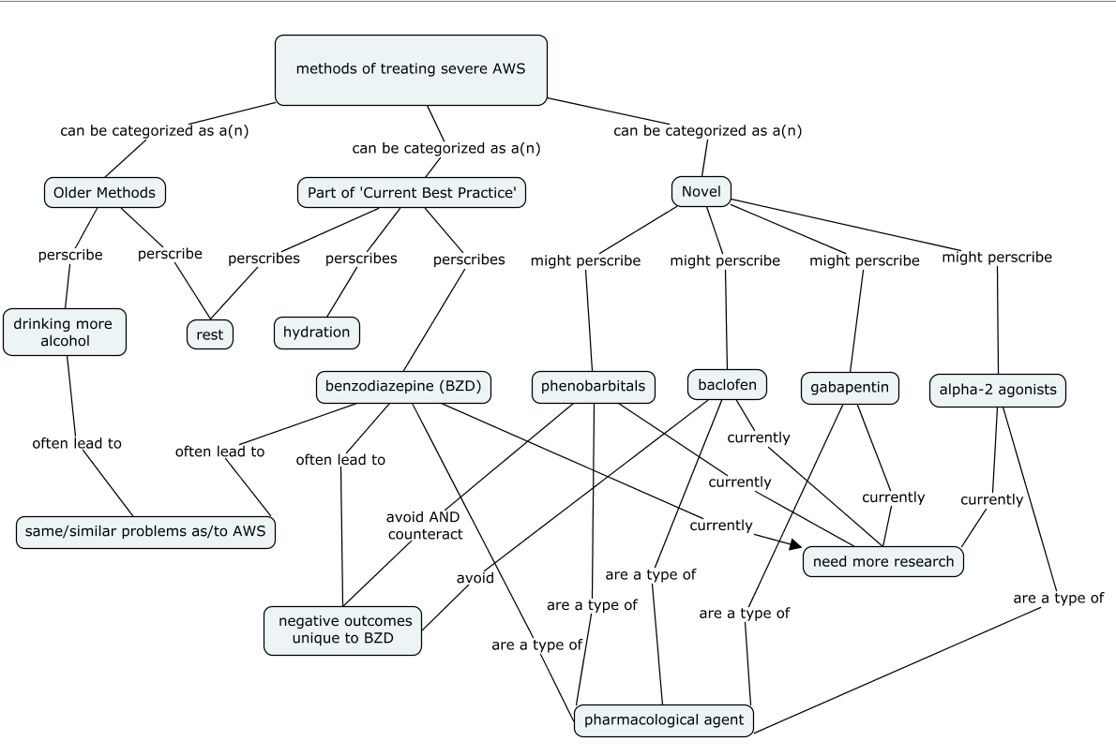
Examples
Classify the dominant structure
Linear
Chain
Hub/spoke
Tree
Network

Slide 25
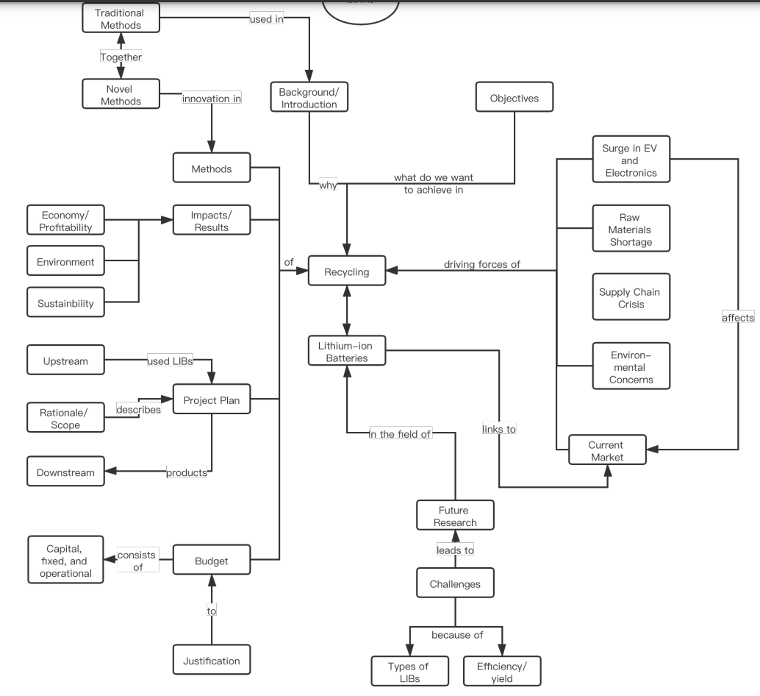
Examples
Classify the dominant structure
Linear
Chain
Hub/spoke
Tree
Network
Secondary
Primary

Slide 26
Quantitative Method: Comparison to Expert (Criterion) Map
Match Metric = Match E / (Miss N + Extra E + Match E)
Match E = No. of matching edges (propositions)
Miss N = No. of missing nodes (concepts)
Extra E = No. of extra edges
[Citation]
Notes:
Other examples of comparison metrics in the literature - overlap, link similarity, link density, etc.
Could also compare similarity of a team’s individual maps

Slide 27
Tip before scoring:
remind students to label lines with linking words or phrases!
Notes:
How would you score this concept map with the traditional method? It might be difficult because the map is missing the linking words. Relationships between concepts and the flow of the map could be unclear and lead to different interpretations and thus different scores between raters.

Slide 28
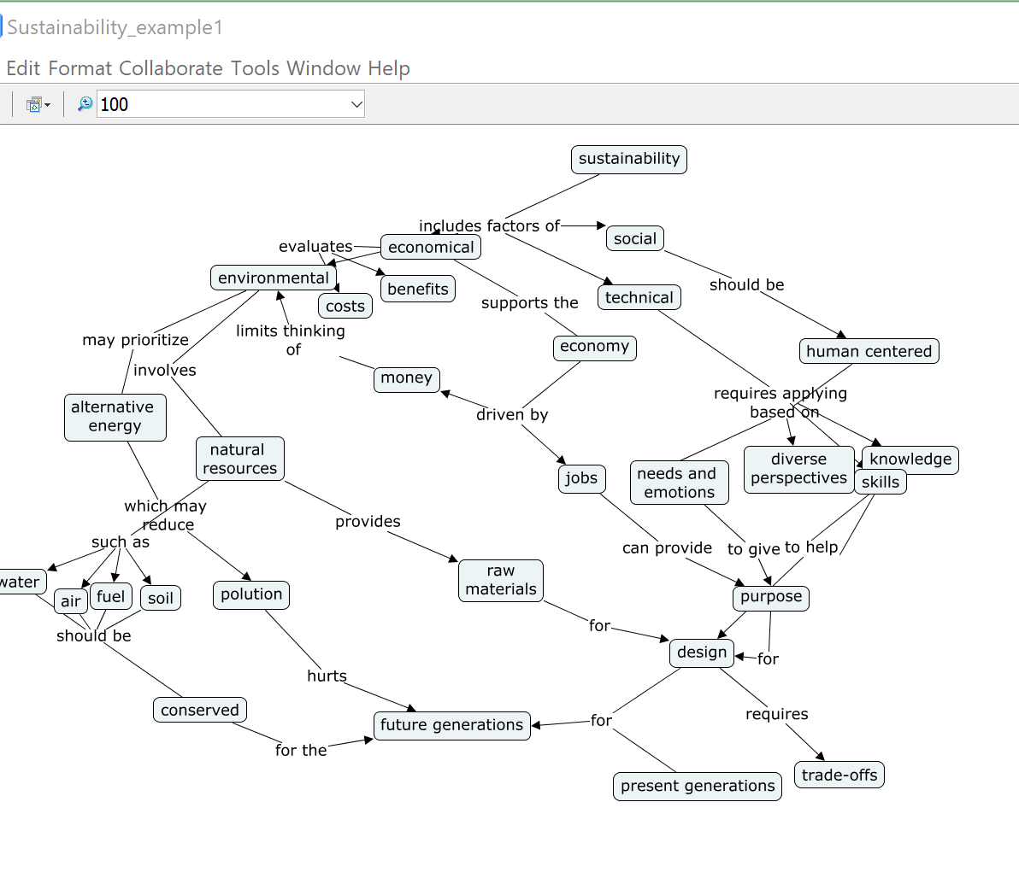
Tip before scoring:
Use autolayout to make all cmaps hierarchical!
Note: you may want to make copies of the student maps so that you can preserve their original layouts for using a scoring approach like “Holistic Structure”.
Notes:
With this layout, the student’s concept map may be difficult for another person to follow. And again, relationships between concepts and the flow of the map could be interpreted differently between raters. It can be really helpful to prompt students to use the autolayout tool BEFORE submitting their cmap. But, you can also do this afterwards, as long as students submit as a .cmap file (or you don’t mind recreating a handwritten map or other in CmapTools).

Slide 29
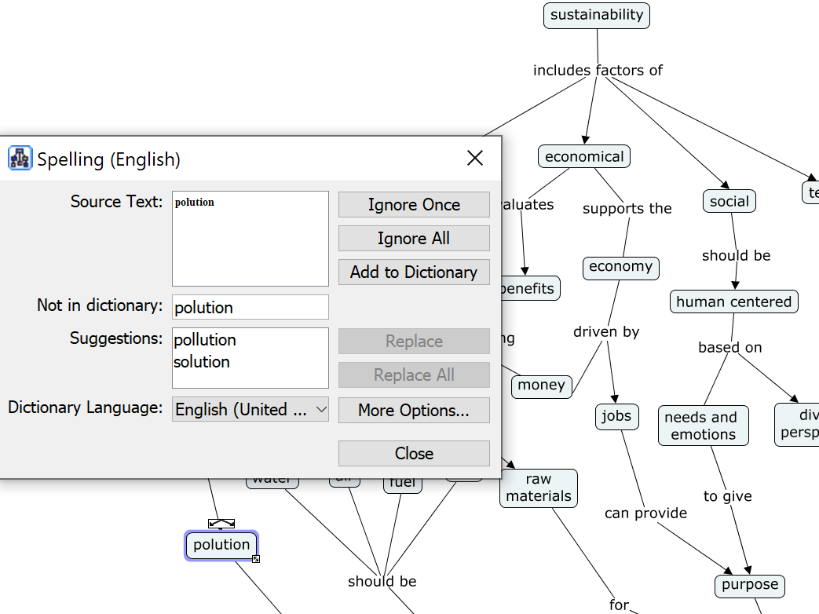
Tip before scoring: Spell check!
Notes:
Prompt students to spell check BEFORE submitting their cmap. But, you can also do this afterwards. It will help a lot with qualitative analysis, whether by hand or automated. Spelling is found under the Tools menu.

Slide 30
References
1. Novak, J. D. and A.J. Cañas, The theory underlying concept maps and how to construct and use them, 2008. <http://eprint.ihmc.us/5/2/TheoryUnderlyingConceptMaps.pdf>.
2. Besterfield-Sacre, M., et al., Scoring Concept Maps: An Integrated Rubric for Assessing Engineering Education. Journal of Engineering Education, 2004. 93(2): p. 105-115.
3. Turns, J., C. Atman, and R. Adams, Concept maps for engineering education: A cognitively motivated tool supporting varied assessment functions. IEEE Transactions on Education, 2000. 43(2).
4. Watson, M.K., et al., Assessing Conceptual Knowledge Using Three Concept Map Scoring Methods. Journal of Engineering Education, 2016. 105(1): p. 118-146.
5. Tulving, E., Episodic and Semantic Memory, in Organization of Memory, E. Tulving and W. Donaldson, Editors. 1972, Academic Press: Oxford, England
6. Ruiz-Primo, A., On the use of concept maps as an assessment tool in science: What we have learned so far. Revista Electrónica de Investigación Educativa, 2000. 2(1): p. 29-53.
7. Martine, M.M., Mahoney, L.X., Sunbury, C.M., Schneider, J.A., Hixson, C., Bodnar C.A. (2019). Concept Maps as an Assessment Tool for Evaluating Students' Perception of Entrepreneurial Mindset. Submitted to ASEE 2019 Annual Conference and Exposition, June 16-19, 2019. Tampa, Florida.
8. Watson, M. K., Barrella, E., & Pelkey, J. (2018). Assessment of conceptual knowledge using a component-based concept map scoring program. The International journal of engineering education, 34(3), 1025-1037.
9. Richmond, S. S., Defranco, J. F., & Jablokow, K. A set of guidelines for the consistent assessment of concept maps. International Journal of Engineering Education, 2014.

Slide 31
To cite this work:
Barrella, E., Bodnar, C.A., Carnasciali, M.I., Cruz, J., Dillon, H.E., Kecskemety, K., Jackson, A.M., Miskioglu, E. (2023). EM Concept Map Toolkit. Licensed under CC BY-NC-SA

